Slide 1
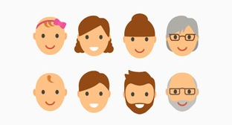
Lifespan Psychology: Adulthood
AEPSY Year 11 ATAR Psychology

Slide 2
Review
Give an example of a fine motor skill in young children.
Give an example of a gross motor skill in older children.
Give an example of a prenatal cognitive (language) skill.
Give an example of an adolescent social-emotional skill.
Explain why teenagers are risk-takers and may have poor judgement.

Slide 3
Review
6. Draw a brain, showing the frontal, mid and hind brain.
7. Explain the function of the corpus callosum.
8. What is the difference between a cross-sectional and a longitudinal study?

Slide 4
Learning Intentions
Lifespan psychology
developmental stages across the lifespan – early adulthood, middle age and older
changes across developmental stages
physical (gross and fine motor skills)
cognitive (language)
social and emotional development

Slide 5
Success Criteria
Give example of a physical, cognitive and social-emotional feature of early, middle and older adult.
Explain mid-life crisis, menopause and tip-of-the tongue phenomenon.

Slide 6
Early Adulthood (20 to 40 years)
Fine and gross motor skills operate at their best
Peak of vocabulary
Intimate relationships (close friendships and romantic relationships) tend to form and dependence on family decreases

Slide 7

Middle Age (40 to 65 years)
Find it difficult to master new motor skills
Verbal fluency declines (but meaning and knowledge of words improves) – Tip of the tongue phenomenon increases with age.
Decrease in negative emotions and increase in positive emotions

Slide 8

Mid-life crisis

Slide 9
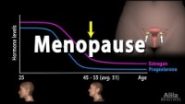
Menopause

Slide 10
Older age (65+)
Fine and gross motor skills decline, movements are slower and complex tasks require more brain activity than they used to.
Speed of language and verbal fluency declines
Smaller and tighter social networks, greater regulation of emotions, maintaining social life increases feelings of self-worth, self-esteem and decreases feelings of shame, depression and guilt due to being more dependent on others.

Slide 11
Success Criteria
Give example of a physical, cognitive and social-emotional feature of early, middle and older adult.
Explain mid-life crisis, menopause and tip-of-the tongue phenomenon.

